Slide 1
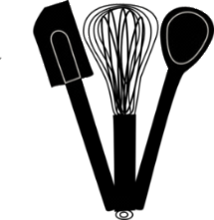
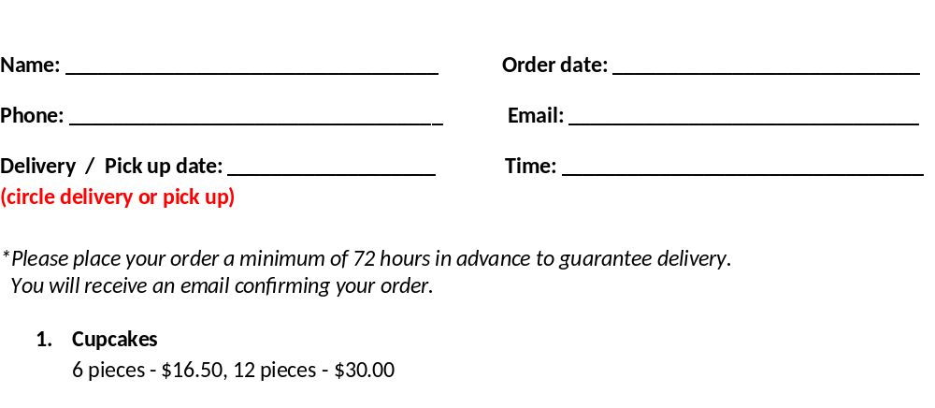
BEYOND THE BOWL BAKING – Order Form
Flavor | Quantity | Total
Divine Chocolate – chocolate infused with chocolate cream topped with a chocolate cream cheese frosting and chocolate shavings
Peaches Supreme – peach topped with brown sugar cream cheese frosting and dried peach slivers
Banana Peanut Butter – banana infused with caramel banana topped with peanut butter cream cheese frosting and peanut butter granola
Totally Tiramisu – infused with Kahlua syrup, topped with Kahlua cream cheese frosting dusted with espresso and cocoa powder
Cinnamon Bun - cinnamon syrup infused topped with cream cheese frosting and cinnamon sugared pecans
Lemon Crème – lemon infused with lemon crème topped with lemon butter cream icing and gold sugar
Ravishing Root Beer – root beer topped with vanilla/root beer cream cheese icing
2. Cakes
Sharing slab - $6.50, Sheet - $25.00
Flavor | Quantity | Total
Smashing Pumpkin w cream cheese frosting
Ultimate Chocolate w chocolate cream cheese frosting
Classic Carrot w cream cheese frosting
Apple Spice Raisin w cream cheese drizzle
Guinness Gingerbread
Order #

